Slide 1
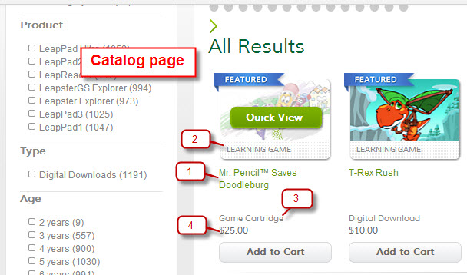
Catalog page:
LF Short Name
Content Type
3. Type/Format
4. Price

Slide 2
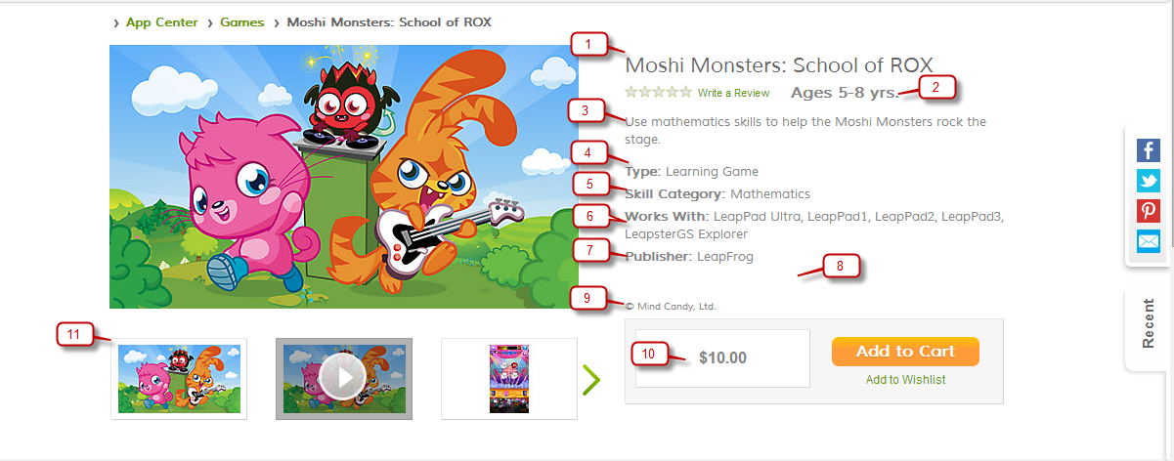
Product Detail page
LF Long Name
Age
LF Description
Content Type
Curriculum
Compatible Platforms
Publisher
Special Message and More Info
Legal Top
Price
Trailer

Slide 3
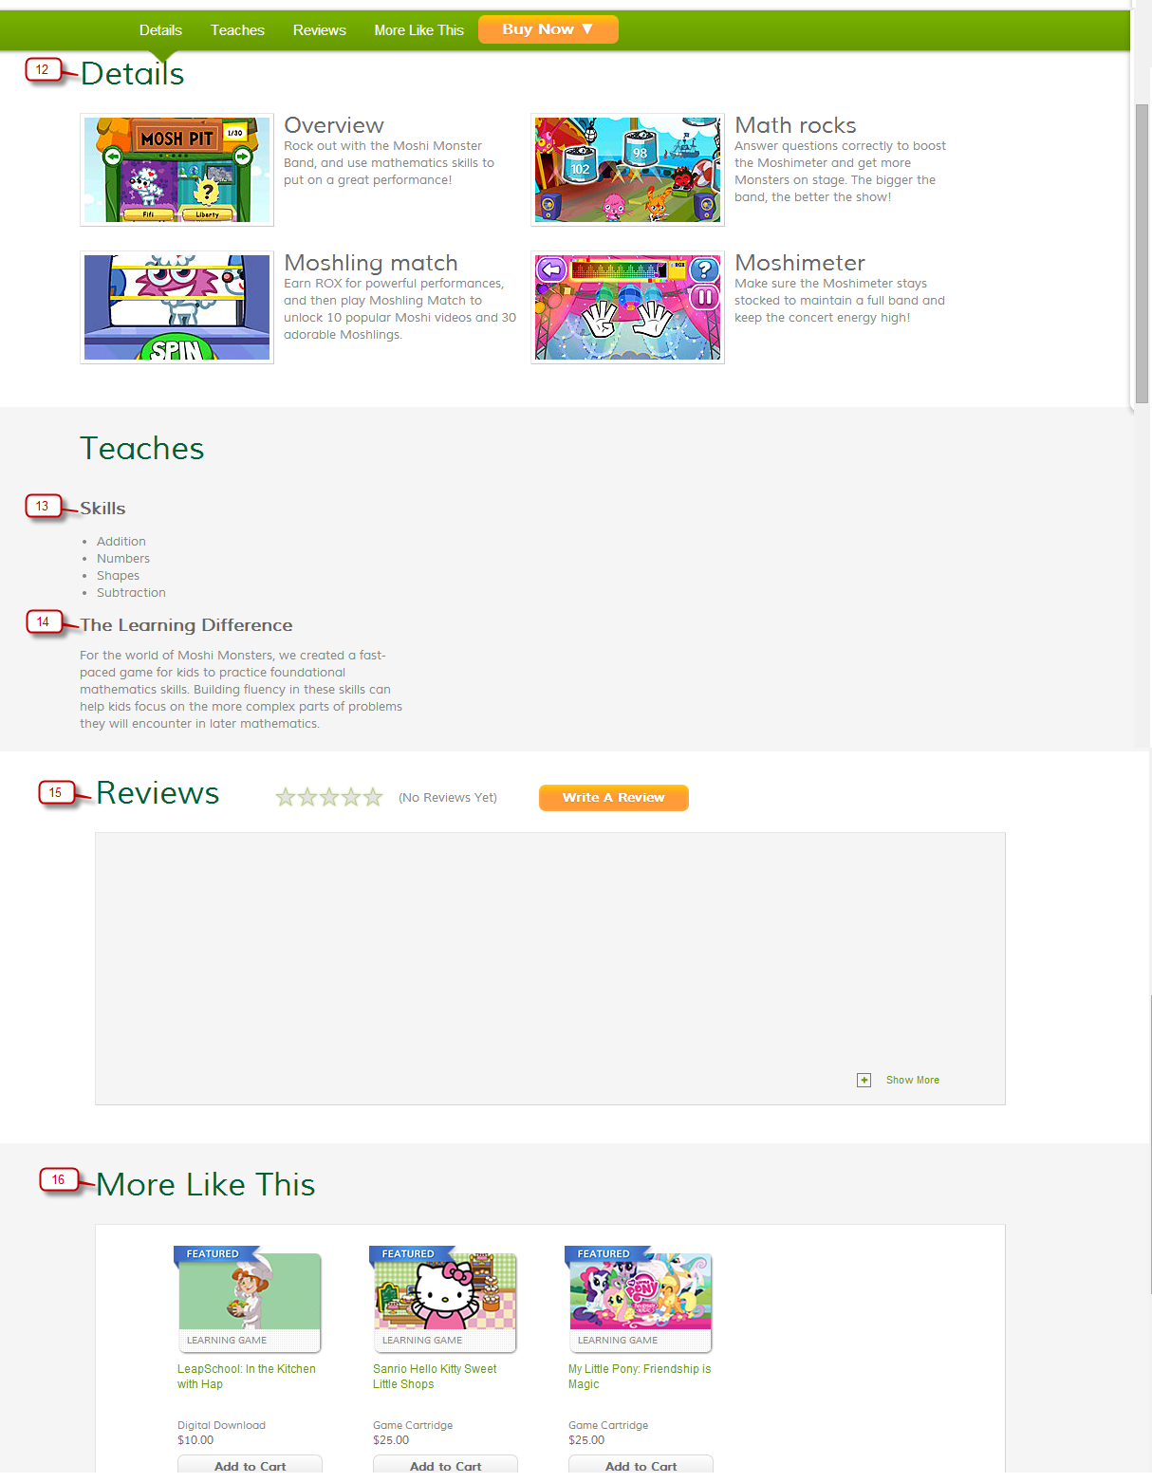
Product Detail page
12. Details Title/Text
13. Teaches Skill
14. Learning Difference
15. Review
More Like This
Legal Bottom

